Slide 1
Sprint 4 Presentation
By: Ryan Wire, Ashley Zingillioglu and Thomas Tacinelli

Slide 2
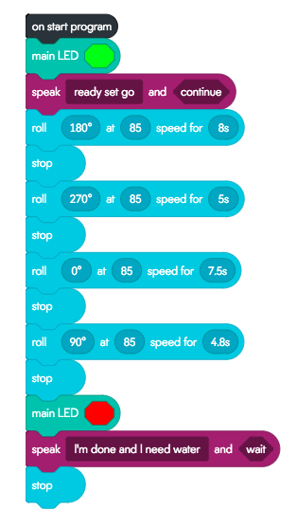
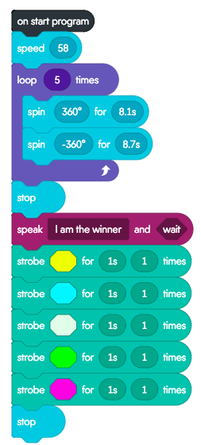
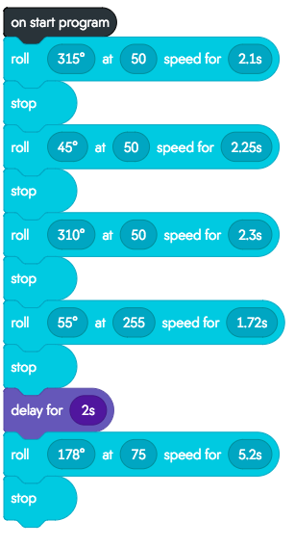
Final block Code for Sprint 1, Sprint 2 and Sprint 3
Sprint 1 Sprint 2 Sprint 3

Slide 3
Sprint 1: Video Performance
https://www.youtube.com/watch?v=6Oq5DL9LG3E&feature=youtu.be

Slide 4
Sprint 2: Video Performance
https://www.youtube.com/watch?v=aQv2Yxqpajc

Slide 5
Sprint 3: Video Performance
https://www.youtube.com/watch?v=MSreCYM9Jbw

Slide 6
Challenges we Had Faced
Not being able to meet on a regular basis or at all.
We had to not only become a cohesive team over Zoom and text message, but also work on something that we were all learning for the first time.
Access to the obstacle courses were limited and sometimes needed to be constructed.
Other scheduling obligations made it so we had to work asynchronously.
We overcame these though...

Slide 7
Roles of each team member
Ashley= Documentor:
made Requirements table
Contributed to block code
Did Section 2 and 3 of SDD

Slide 8
Roles of Each Team Member
Ryan= Project Manager:
Finalizing SDD
Ensuring group mates are fulfilling their roles
Making sure all requirements are met
Created flowchart

Slide 9
Roles of Each Team Member
Thomas= Tester:
Created the Gantt chart
Created sensor data diagram
Built test table
Created the robot video

Slide 10
What have you learned about software engineering?
A list of steps of a proposed solution to a problem
Trial and error
Divide and conquer
User involvement
Revisions
Proper utilization of resources

Slide 11
What would you do differently?
Sprint 1- Create a more accurate program where the robot finishes the program exactly where it started.
Sprint 2- Create a more accurate program that would execute the turns, around the circles, in a more precise fashion. That way the robot would finish exactly where it started.
Sprint 3- Our program for sprint 3 had little to no problems as it avoided all three obstacles, completed the ramp jump, and knocked down all ten pins. However the ramp that we constructed could have been a little more sturdy and the robot could have executed the sharp turn in a more precise fashion.

